Slide 1



UNIT 6; The time of your life
Holiday plans

Slide 2
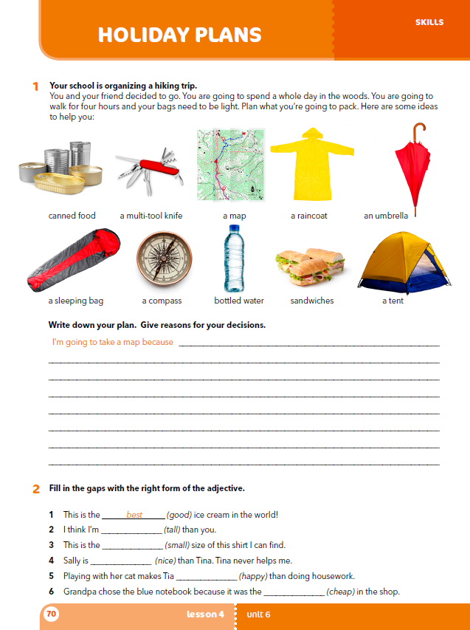
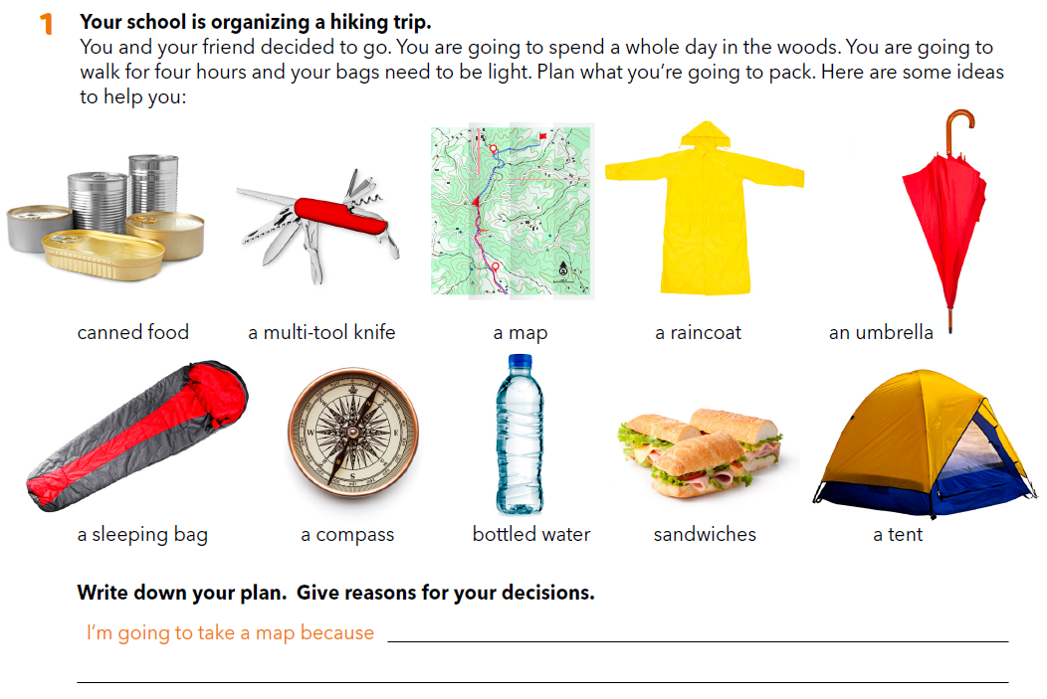
Workbook, p. 70
What do you do during holidays?
Who do you spend time with?

Slide 3
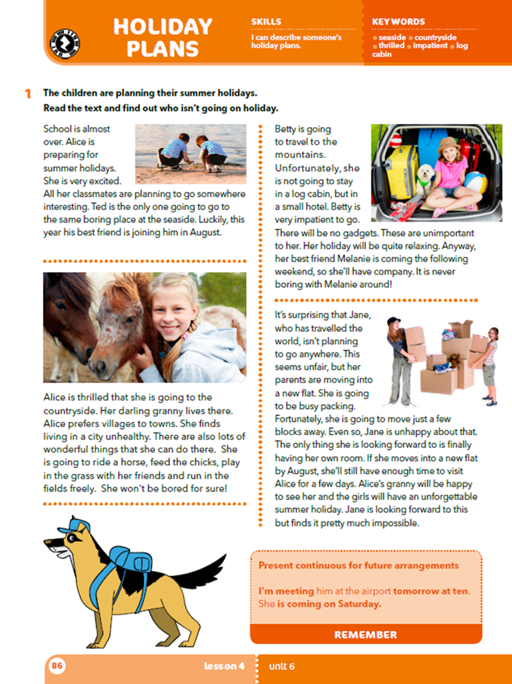
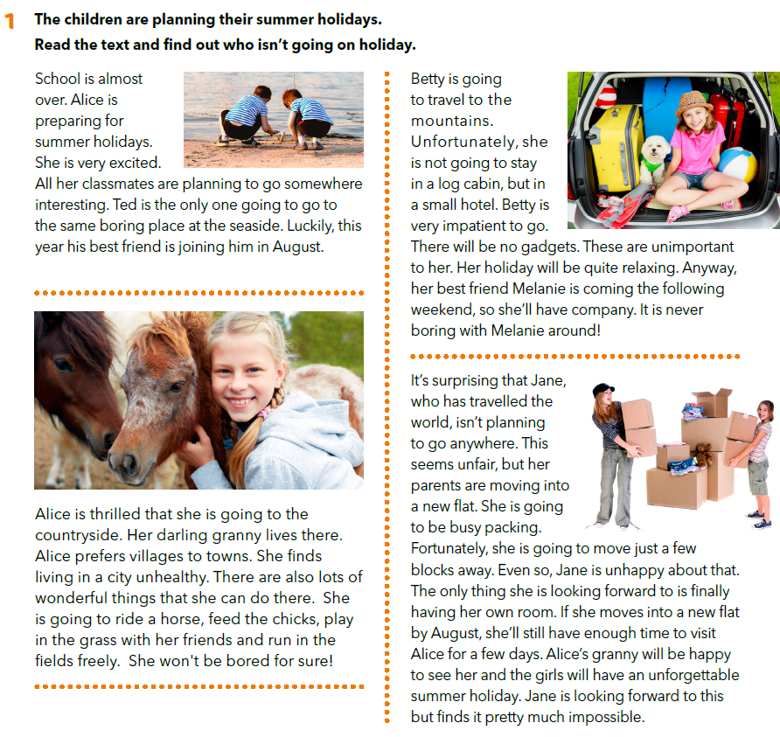
Open your book, page 86!
Ted is going to the seaside.
Alice is going to the countryside.
Betty is going to the mountains.
Jane isn’t going on holiday.

Slide 4
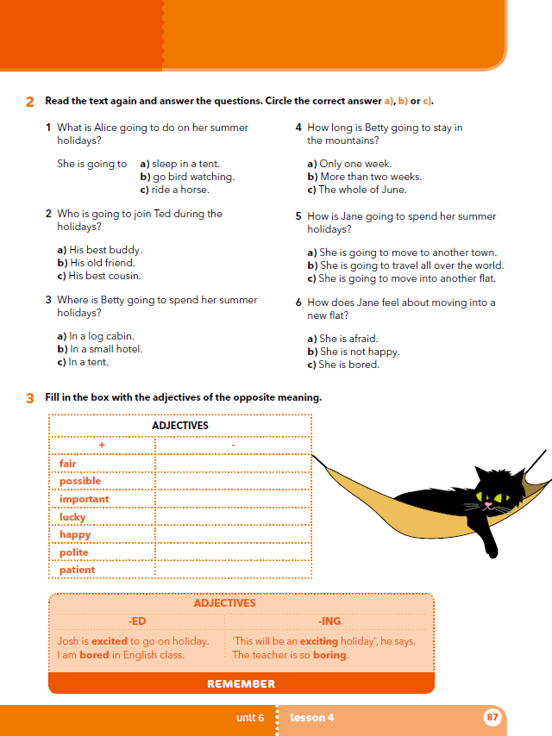
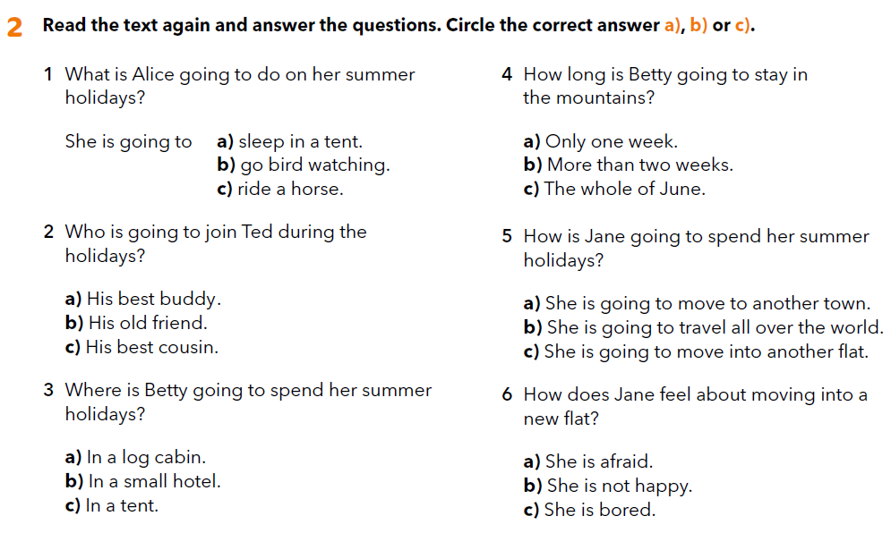


Slide 5
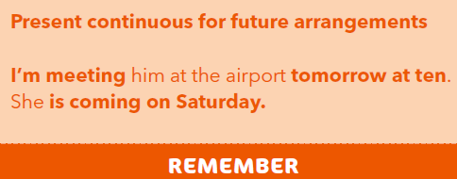
Za BUDUĆE radnje koje su već dogovorene koristit ćeš glagolsko vrijeme Present Continuous.
I am writing the test tomorrow.
You are writing…
He is writing…
She is writing…
We are writing…
You are writing…
They are writing…

Slide 6
Odaberi jedno od navedenih zamišljenih odredišta za praznike:
New York,
camping in the woods
camping by the lake
hotel by the seaside
tent in the garden
mountain cabin
a house by a river Potom zapiši što ondje planiraš raditi.
Tijekom pisanja pripazi da: a) tekst treba biti zanimljiv b) treba navesti barem pet aktivnosti c) koristiti going to future za planirane radnje

Slide 7
Who is Alice going to visit for summer holidays? Is Betty going to travel to the seaside? Is she going to have some company? Whose parents are going to move into a new flat? Who might visit Alice for a few days? Is anyone going to spend summer holidays camping? What do you need when you go camping?

Slide 8
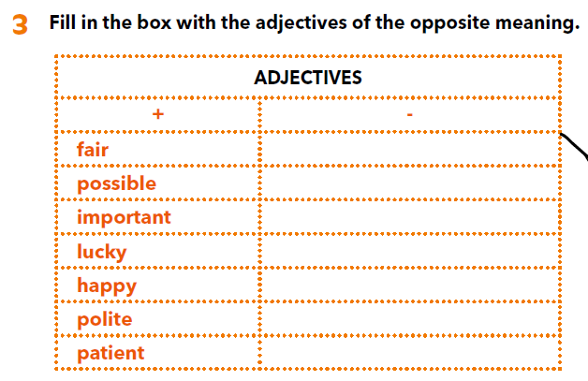
Who is unhappy about her/his summer plans?
How does Betty feel about her summer in the mountains?
Does Jane think she is likely to go to Alice’s granny this summer?
How does Betty feel about gadgets?
unfair
impossible
unimportant
unlucky
unhappy
impolite
impatient
Primjećuješ li da smo ispred pridjeva stavljali prefiks UN- ili IM-.
Let’s practise:
https://learningapps.org/watch?v=p7eshswen20

Slide 9
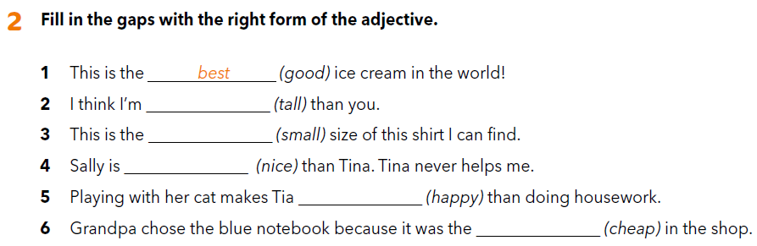
workbook, p. 70
taller
smallest
nicer
happier
cheapest

Slide 10
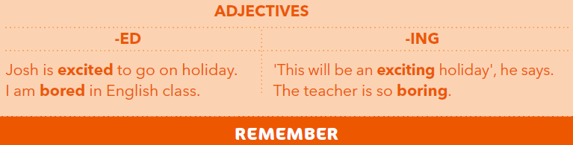
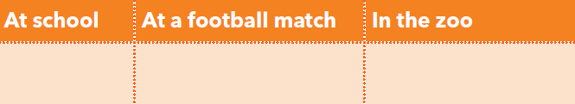
U engleskom jeziku postoji posebna skupina pridjeva koji djeluju slično, a razlikuju se u nastavku ali i u značenju. Jedni završavaju na -ed, a drugi na -ing. Pridjevi koji završavaju na -ed opisuju kako se ljudi osjećaju,
I am bored.
dok pridjevi koji završavaju na -ing opisuju stvari i situacije.
This lesson is boring.
How do you feel in these situations?

Slide 11
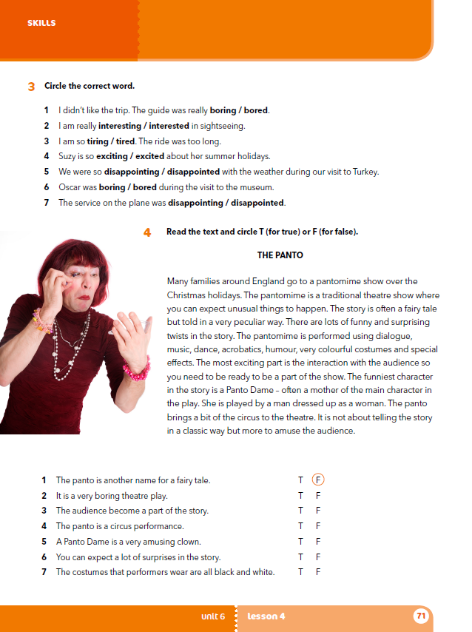
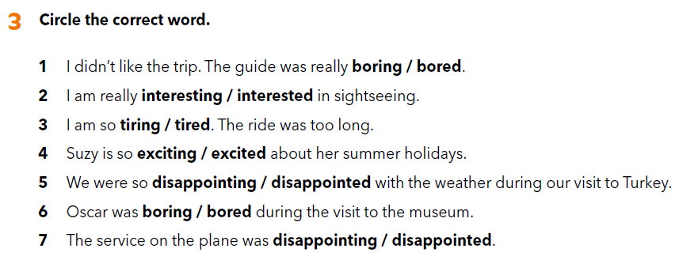
Workbook, p. 71

Slide 12
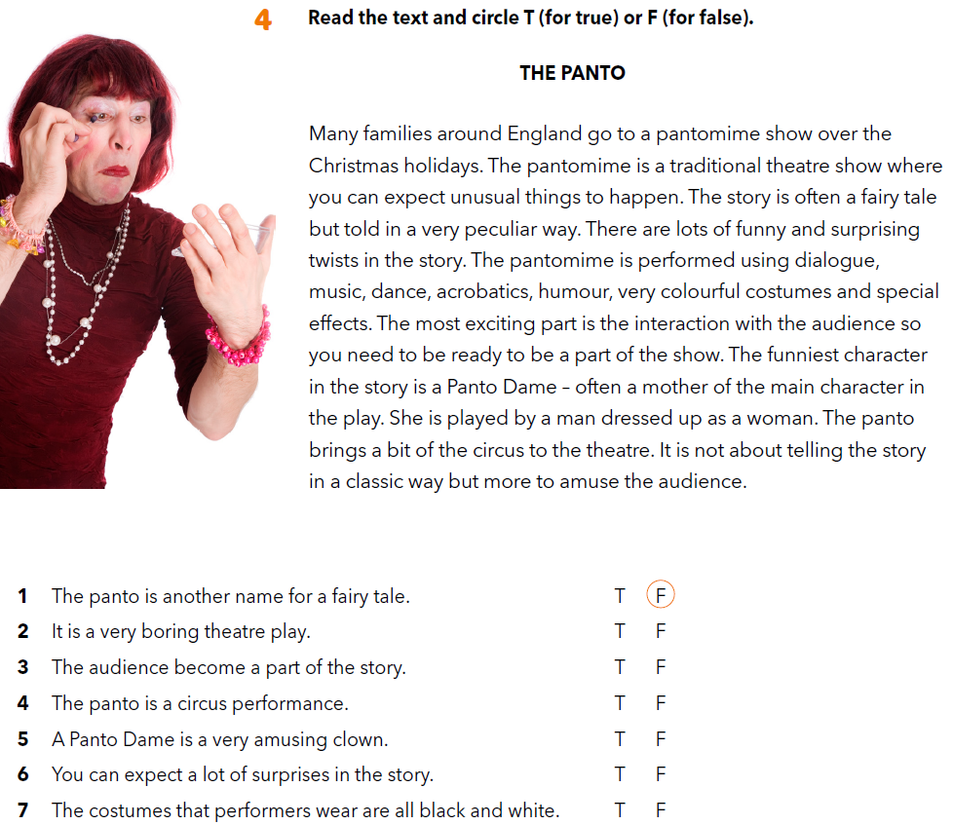

Slide 13

LEARN MORE
https://www.e-sfera.hr/dodatni-digitalni-sadrzaji/49bfd946-b720-4d87-9ecb-35ce121e3415/
A busy weekend

